Slide 1
Deepfakes

Slide 2
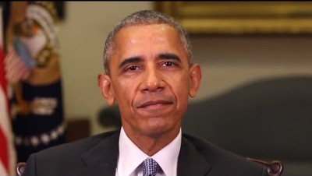
Video 1: Barack Obama
Link: https://www.youtube.com/watch?v=cQ54GDm1eL0&t=27s&ab_channel=BuzzFeedVideo

Slide 3
Check out the videos below. Which are real and which are fake?
Make a list and note which videos you think have been manipulated.

Slide 4
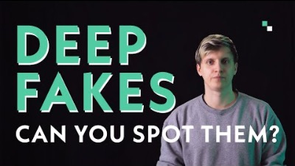
Do you recognize the deepfakes? (Test starts at 05:15)
Link: https://www.youtube.com/watch?v=qj5LqiSabP4&ab_channel=LICHTCATCHTOBY

Slide 5
Solution of the quiz
Video 1 - real Video 2 - fake Video 3 - real Video 4 - real Video 5 - real | Video 6 - fake Video 7 - real Video 8 - real Video 9 - fake Video 10 - real
Link zu den Lösungen: https://www.youtube.com/watch?v=VtW9la3tKBo&ab_channel=LICHTCATCHTOBY

Slide 6
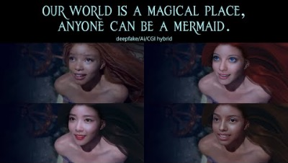
Link: https://www.youtube.com/watch?v=jCQ-UwSqn8E&ab_channel=KarolyHamza

Slide 7
Collect everything you can think of about the term "fake". Where do you encounter fakes in everyday life? When do you use the term "fake"?

Slide 8
Fake = falsification; Dizziness; something invented; something staged
fake something = misrepresent something, falsify; appear under a false name

Slide 9
And what are deepfakes?

Slide 10
Deepfakes are manipulated or artificially generated sound or image media, which, however, look real.
They show people who seem to say or do something but have never said or said.
Deepfakes are created with artificial intelligence, such as machine learning and deep learning.
Vgl.: https://www.europarl.europa.eu/RegData/etudes/STUD/2021/690039/EPRS_STU(2021)690039_EN.pdf

Slide 11
Research task
Watch 1-3 videos from the list below!
Write down information about deepfakes that seem important to you (definitions, examples, risks, etc.)!

Slide 12

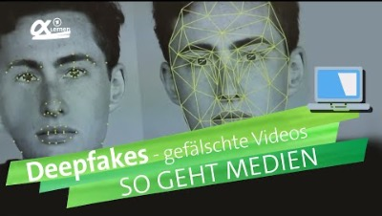
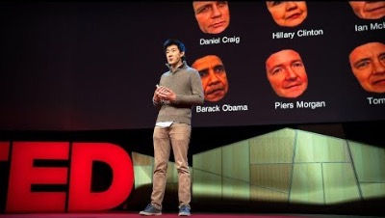
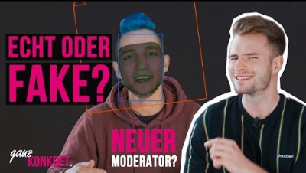
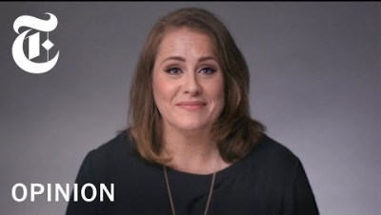
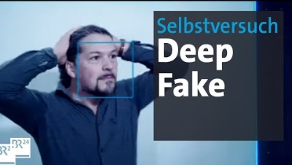
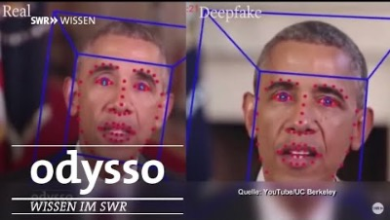
Research task

Slide 13
How do you create deepfakes and what technical knowledge is required?

Slide 14
How to create deepfakes?
Generative Adversarial Networks (GANs): analyze images to create new images of comparable quality Autoencoders: extract information about facial structures from images and use this information to model a new facial expression

Slide 15

Think in small groups and collect examples: Who benefits from deepfakes? Who do they harm? What risks do they entail? How can deepfakes influence our opinion-forming Think about strategies: how can manipulative deepfakes be exposed? Who could do anything about deepfakes on a political and legal level?

Slide 16
What do you think? Can deepfakes even be legal?

Slide 17
Can deepfakes even be legal?
A picture or video of a person must never be published just like that → "Right to one's own image“ Pictures of celebrities may only be used if they consciously go public.

Slide 18
We create our own deepfakes
Download the Wombo app Take a selfie Select video
Please note that the persons depicted must agree and that no damage should be caused!

